Slide 1
Like Build-a-Bear
…
But Not…
Character Builder; Ethan Wagner, Deegii Bayarsaikhan, Travis Plunkett

Slide 2
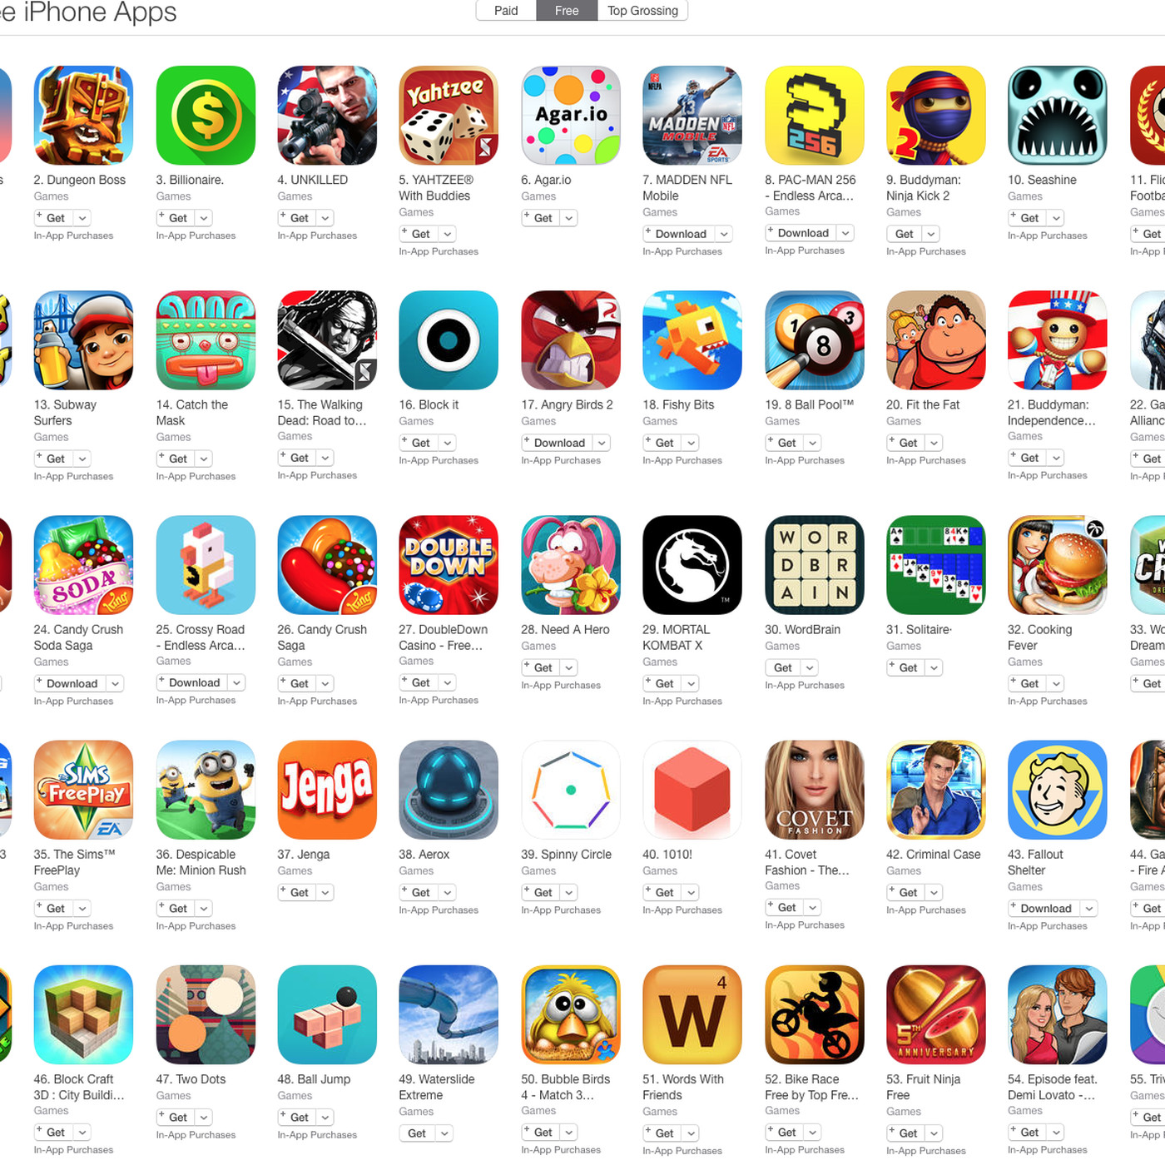
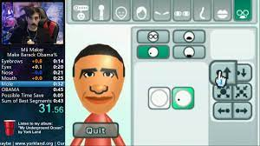
Customization Apps are Rather Trendy

Slide 3
For Better or For Worse… These Types of Games
Appeal to Our Generation. Our Concept Can Apply to These Types of Games… because we need more :)

Slide 4
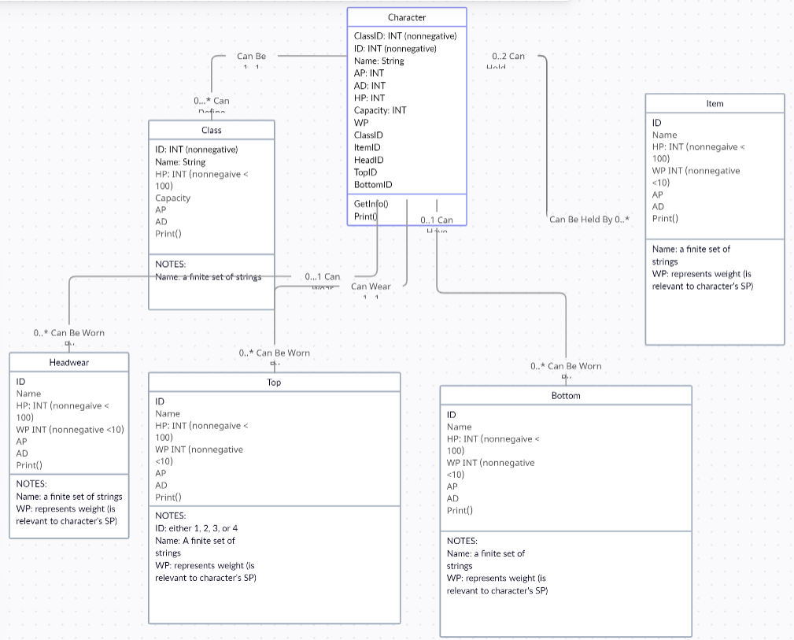
The Concept

Slide 5

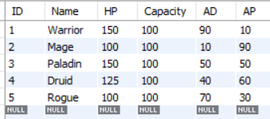
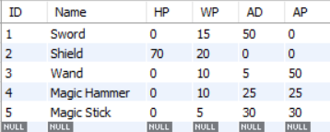
Our schema
Character
Item
Class

Slide 6
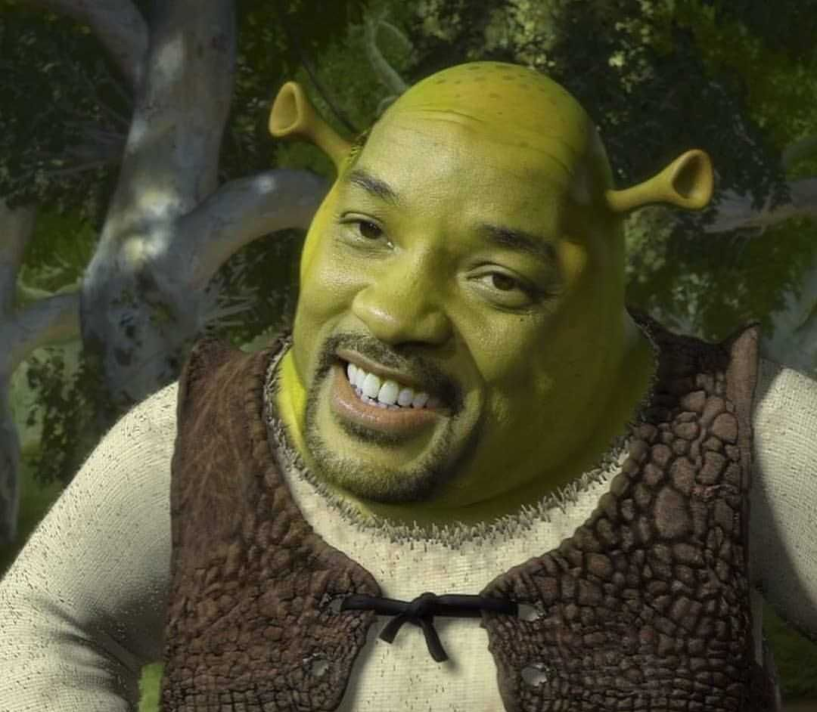
Assumptions
The user is constrained to choosing from our unchanging set of customization items. Data from our code would reflect in a future app.

Slide 7
What Have We Created?

Slide 8
Challenges?
When to use: INSERT INTO VALUES vs UPDATE SET WHERE
SQL has the best error messages in the world… so no problems there.
Trial and error for beautifying our table (pandas, tabulate, sqlite3, etc)
Unbound error for some of our python variables

Slide 9
Improvements?
Graphical Representation (Open AI Image generator?? Simple…)
More Customization! – Allow users to add special items to DB:
ex: “I wan’t my Piet character to have a Trip To Pluto Slide as his weapon!”
Character Battle Realm - Interface our Data with an app!

Slide 10
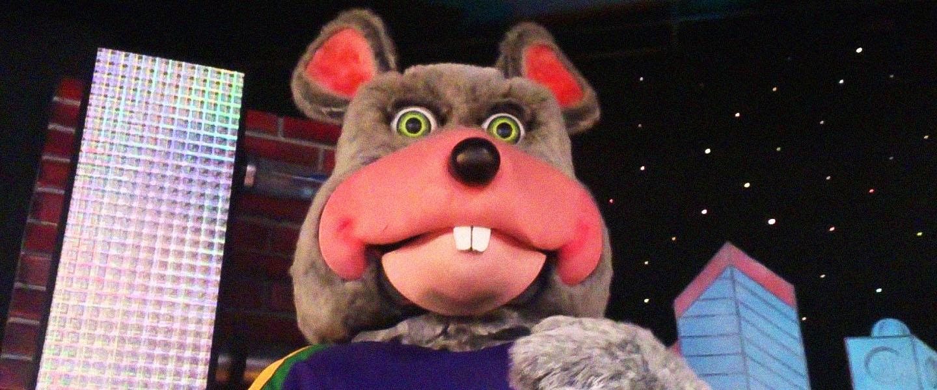
Thank You!
Now be Careful What You Create…

